Slide 1
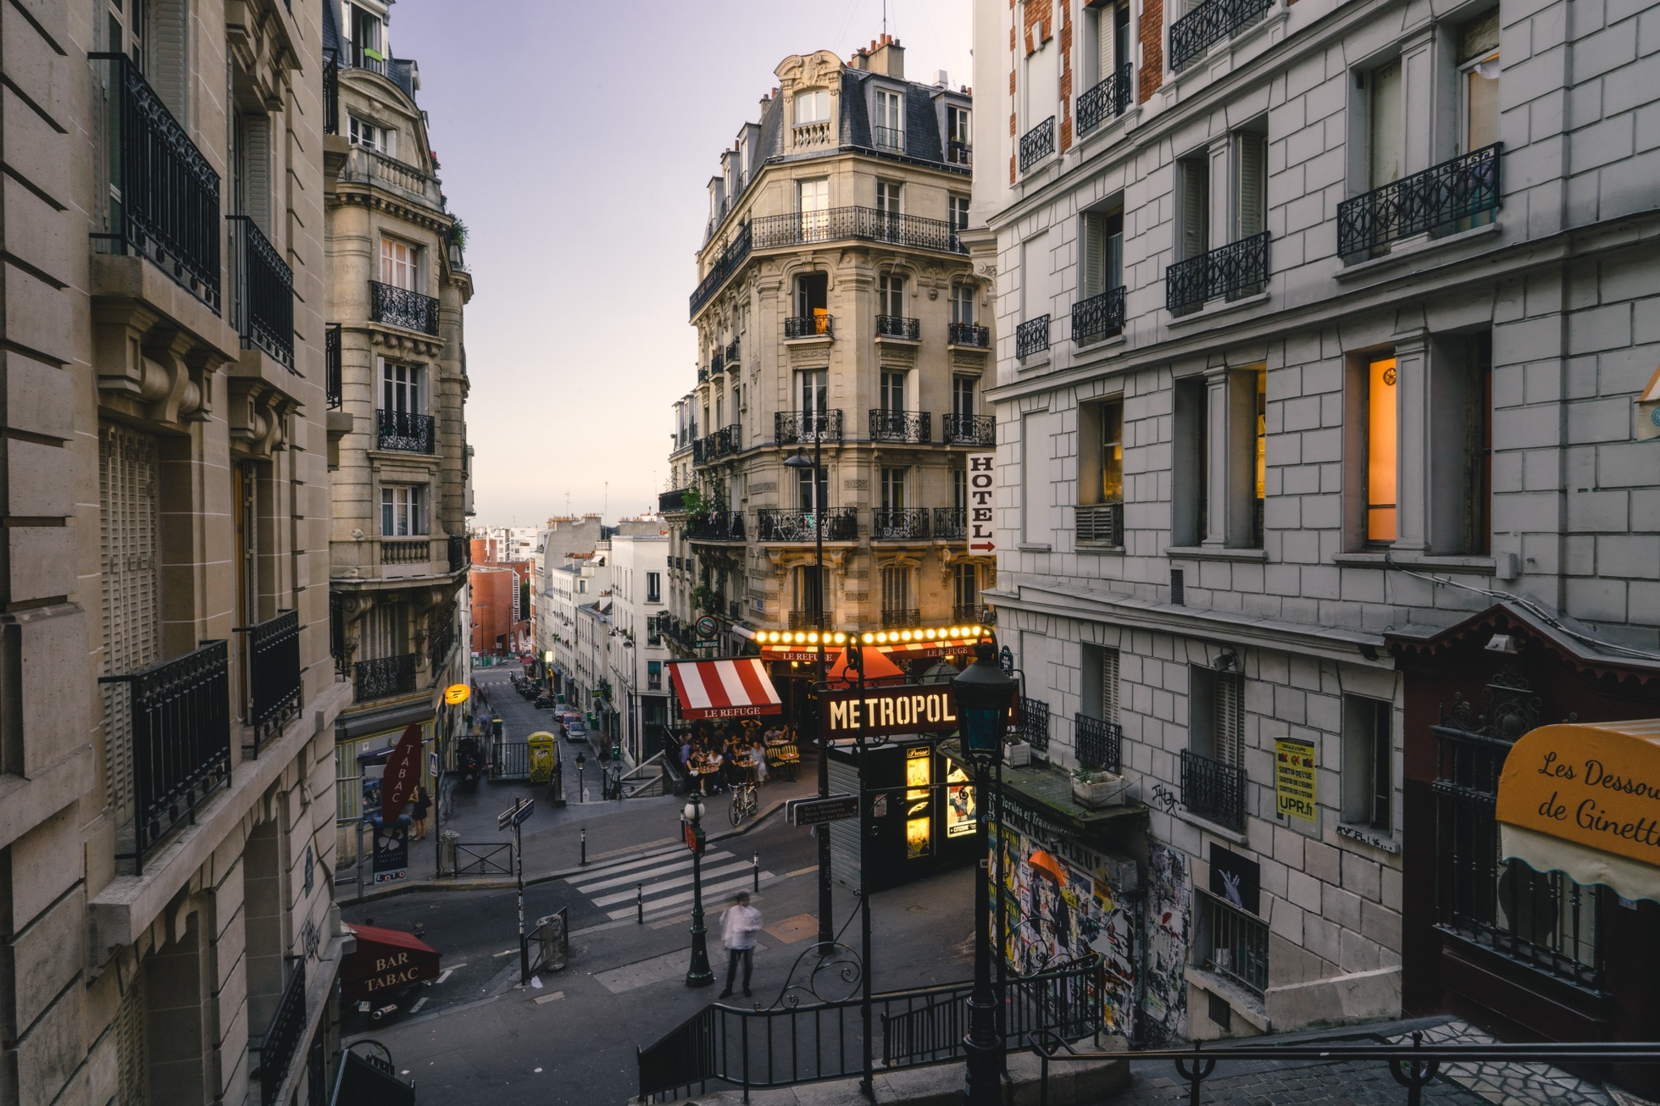
Europe Travel Itinerary
THIS SLIDE PROVIDES AN OVERVIEW OF THE EUROPE TRAVEL ITINERARY, OUTLINING THE KEY DESTINATIONS AND ACTIVITIES TO BE EXPLORED DURING THE JOURNEY.

Slide 2
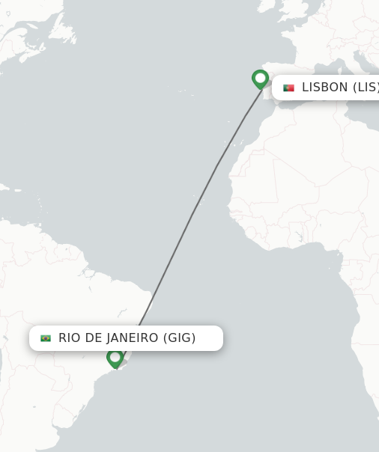
Rio de Janeiro to Lisbon
The journey begins with a 10-hour flight from the vibrant city of Rio de Janeiro to the historic capital of Portugal, Lisbon. Travelers will soar over the vast Atlantic Ocean, catching glimpses of the iconic Christ the Redeemer statue and the stunning beaches of Brazil before touching down in Europe. Lisbon, with its charming cobblestone streets, colorful buildings, and rich cultural heritage, will serve as the starting point for an unforgettable adventure through the continent.

Slide 3



Lisbon Highlights
JERÓNIMOS MONASTERY
BELÉM TOWER
PRAÇA DO COMÉRCIO
A masterpiece of Manueline architecture, the Jerónimos Monastery features ornate stone carvings and grand arched cloisters.
This iconic 16th-century tower stands guard over the Tagus River, known for its intricate stonework and historic significance.
The grand Praça do Comércio, or Commerce Square, is a lively public plaza overlooking the river, featuring neoclassical buildings and stunning views.
LISBON'S ICONIC LANDMARKS, FROM THE JERÓNIMOS MONASTERY TO THE BELÉM TOWER AND PRAÇA DO COMÉRCIO, OFFER A CAPTIVATING GLIMPSE INTO THE CITY'S RICH HISTORY AND ARCHITECTURAL HERITAGE.

Slide 4
Barcelona Exploration
DAY 1
DAY 3
DAY 5
Depart Lisbon by high-speed train to Barcelona, a 2.5-hour journey.
Explore the whimsical Park Güell, a UNESCO World Heritage site designed by Gaudí.
Tour the Gothic Quarter, the historic and charming old town of Barcelona.
DAY 2
DAY 4
Visit the iconic Sagrada Familia, the unfinished masterpiece by Antoni Gaudí.
Stroll along the lively Las Ramblas, a famous tree-lined pedestrian mall in the heart of Barcelona.

Slide 5
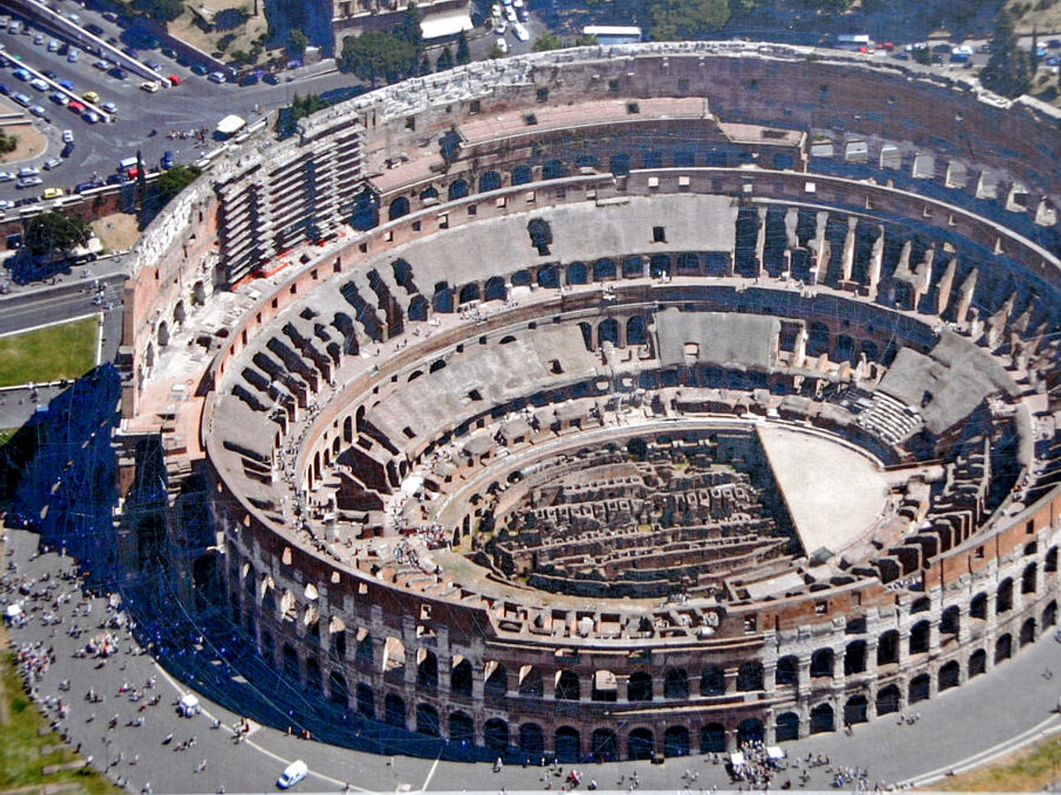
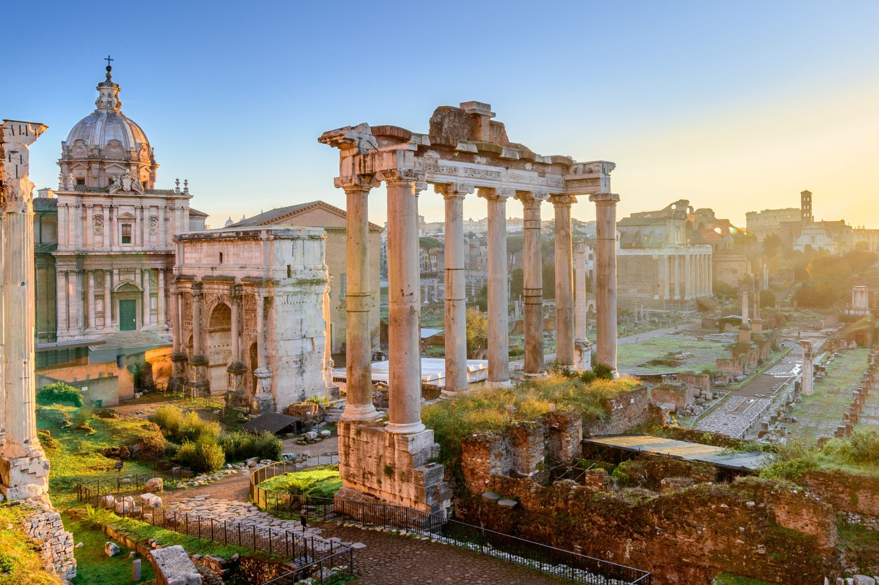
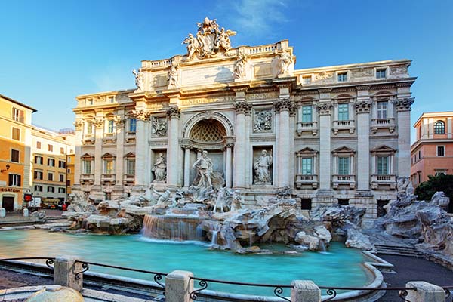
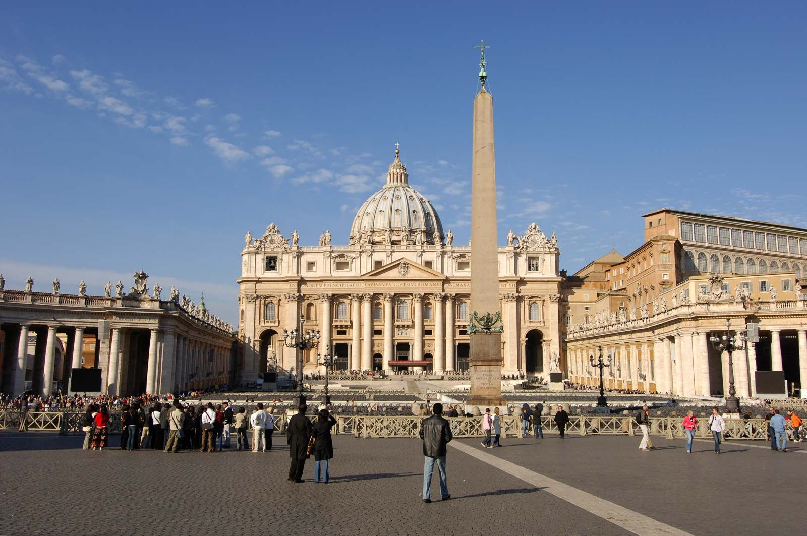
Rome Revelation
COLOSSEUM
ROMAN FORUM
TREVI FOUNTAIN
VATICAN CITY
The iconic Roman amphitheater, where gladiators and wild animals once battled for the entertainment of the masses.
The political, economic, and religious center of ancient Rome, with ruins of temples, basilicas, and government buildings.
The magnificent Baroque fountain, known for its stunning architecture and the tradition of throwing coins to ensure a return to Rome.
The independent city-state that serves as the headquarters of the Catholic Church, home to St. Peter's Basilica and the Sistine Chapel.

Slide 6
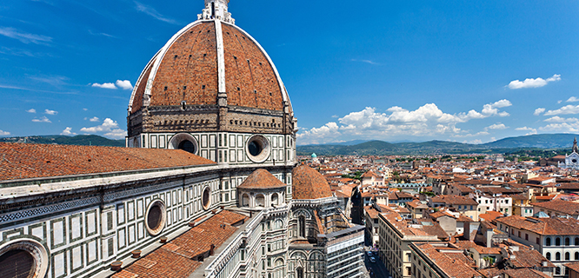
Florence Fusion
Florence, the capital of Italy's Tuscany region, is a city rich in art, architecture, and history. Travelers will have the opportunity to admire the impressive Duomo, a massive cathedral with a distinctive Renaissance dome, the Galleria dell'Accademia, which houses the iconic statue of David by Michelangelo, and the Piazza della Signoria, a lively public square surrounded by historic buildings and sculptures.

Slide 7
Venetian Voyage
FROM FLORENCE
The travelers will depart from the picturesque city of Florence, the birthplace of the Renaissance, and make their way to the enchanting city of Venice.
ICONIC CANALS
In Venice, the travelers will experience the city's famous network of canals, gliding through the waterways in traditional Venetian gondolas and admiring the stunning architectural facades lining the canals.
RIALTO BRIDGE
The travelers will visit the iconic Rialto Bridge, one of the most recognizable landmarks of Venice, and marvel at its stunning design and the bustling market that takes place on the bridge.
PIAZZA SAN MARCO
The travelers will venture to the renowned Piazza San Marco, the heart of Venice, where they will admire the grand Basilica of San Marco and the iconic Campanile bell tower, and soak in the lively atmosphere of this historic square.

Slide 8
Amsterdam Adventure
ANNE FRANK HOUSE
RIJKSMUSEUM
Explore the historic house where Anne Frank and her family hid during World War II, and learn about their harrowing story of resilience and hope.
Visit the renowned Rijksmuseum, home to an impressive collection of Dutch Golden Age paintings, including masterpieces by Rembrandt and Vermeer.
CHARMING CANALS
DAM SQUARE
Discover the beauty of Amsterdam's iconic canals, lined with historic buildings and bridges, and take a relaxing boat tour to experience the city from the water.
Explore the lively Dam Square, the central hub of Amsterdam, featuring the Royal Palace, the New Church, and numerous shops and cafes.

Slide 9


Parisian Passion
Landmark
Description
Eiffel Tower
The iconic wrought-iron lattice tower, standing at 1,063 feet tall, offers panoramic views of the city from its observation decks.
Louvre Museum
The world's largest art museum and a historic monument, housing thousands of priceless works of art, including the Mona Lisa and the Venus de Milo.
*Data obtained from Britannica.com

Slide 10


London Landmarks
BUCKINGHAM PALACE
TOWER OF LONDON
PALACE OF WESTMINSTER
The official residence of the Queen, known for its iconic facade and the Changing of the Guard ceremony.
A historic castle on the banks of the River Thames, home to the Crown Jewels and famous as a former prison.
The meeting place of the House of Commons and the House of Lords, home to the iconic Elizabeth Tower and Big Ben.
LONDON IS A CITY RICH IN HISTORY AND CULTURE, OFFERING TRAVELERS THE CHANCE TO EXPLORE SOME OF ITS MOST ICONIC LANDMARKS AND EXPERIENCE THE GRANDEUR OF BRITISH ROYAL AND POLITICAL HERITAGE.

Slide 11
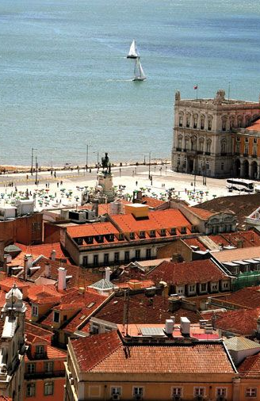
Back to Lisbon
The trip's final destination is Lisbon, where travelers will have the chance to revisit any attractions they may have missed during their previous exploration of the city. This return to the vibrant capital offers a chance to delve deeper into the city's rich cultural heritage, from the iconic Jerónimos Monastery to the lively Praça do Comércio, and to savor the unique flavors of traditional Portuguese cuisine once more.

